Slide 1
Between Ruins and Riches: Contemporary Guatemala in Historical Perspective
Faculty Led
STUDY ABROAD PROGRAM
June 4-21, 2024, 18 days
Notes:
Learn from Travel is the provider for this program

Slide 2
Why study abroad?
Earn credit while seeing the world
Employers love it
Enhance your transfer applications
Build cultural intelligence
Become a global citizen

Slide 3
Advantages of faculty-led programs
Most affordable study abroad option
Hand picked immersive experiences
Safer and more structured
Shorter and more convenient
Interaction with faculty

Slide 4
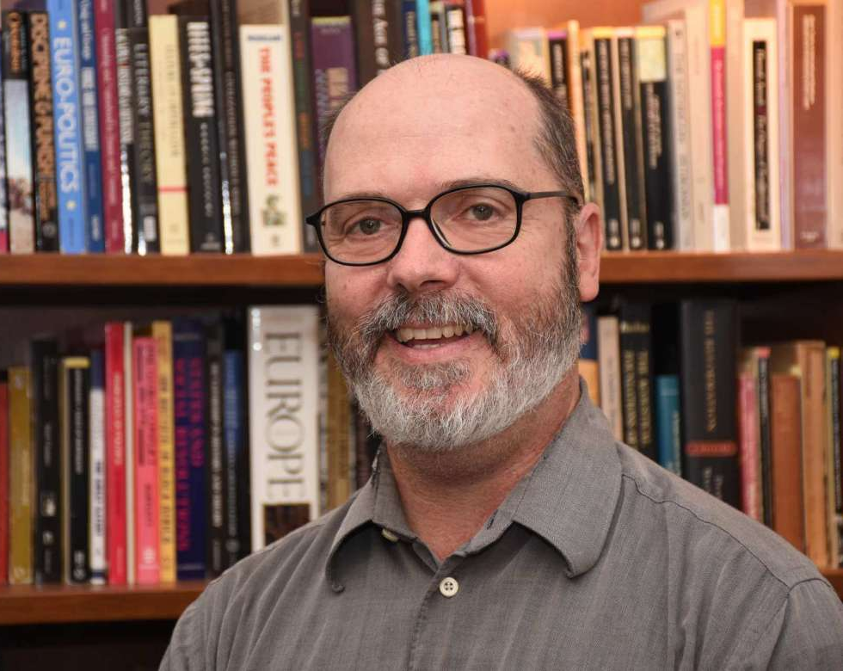
Faculty Leader
Dr. Keith Alexander
Associate Professor of History
Modern Germany, Modern Europe, Environmental History, Historic Preservation, Oral History, History and Culture of Cuba

Slide 5
UNESCO World Heritage Site
Notes:
Historical walking tour of Antigua with historian, Guillermo Montoya
Students will take to the streets of the UNESCO World Heritage site of Antigua to learn about some of the key buildings, landmarks, and history of the antique capital.

Slide 6
Cerro de la Cruz Lookout
Notes:
Enjoy panoramic views of the city of Antigua from the “Cerro de la Cruz” lookout.
Meet with local education NGO ‘Los Patojos’
Group will travel to the nearby town of Jocotenango to discuss their Los Patojos programs and some of the challenges facing Guatemalan students and communities.

Slide 7
Iximche Ruins
Notes:
1.5 hour transfer to Iximche Ruins
Tour of Iximche Mayan Ruins
Students will be led by a local indigenous guide through the ancient site, ceremonial area, and museum learning about the history and traditions of the ancient Maya.
Traditional lunch at Iximche

Slide 8
Cerro Quemado Hike
Notes:
Travel to the nearby sacred cultural site of 'Cerro Quemado' with Xela Adventures
Students will hike with local guides to learn about the importance of this site and why nearby indigenous populations make the pilgrimage.

Slide 9
Fuentes Georginas Hot Springs
Notes:
Visit “Fuentes Georginas” hot springs in the town of Zunil
Rejuvenating thermal waters located in the skirts of the Zunil volcano surrounded by lush, forested hillsides.

Slide 10
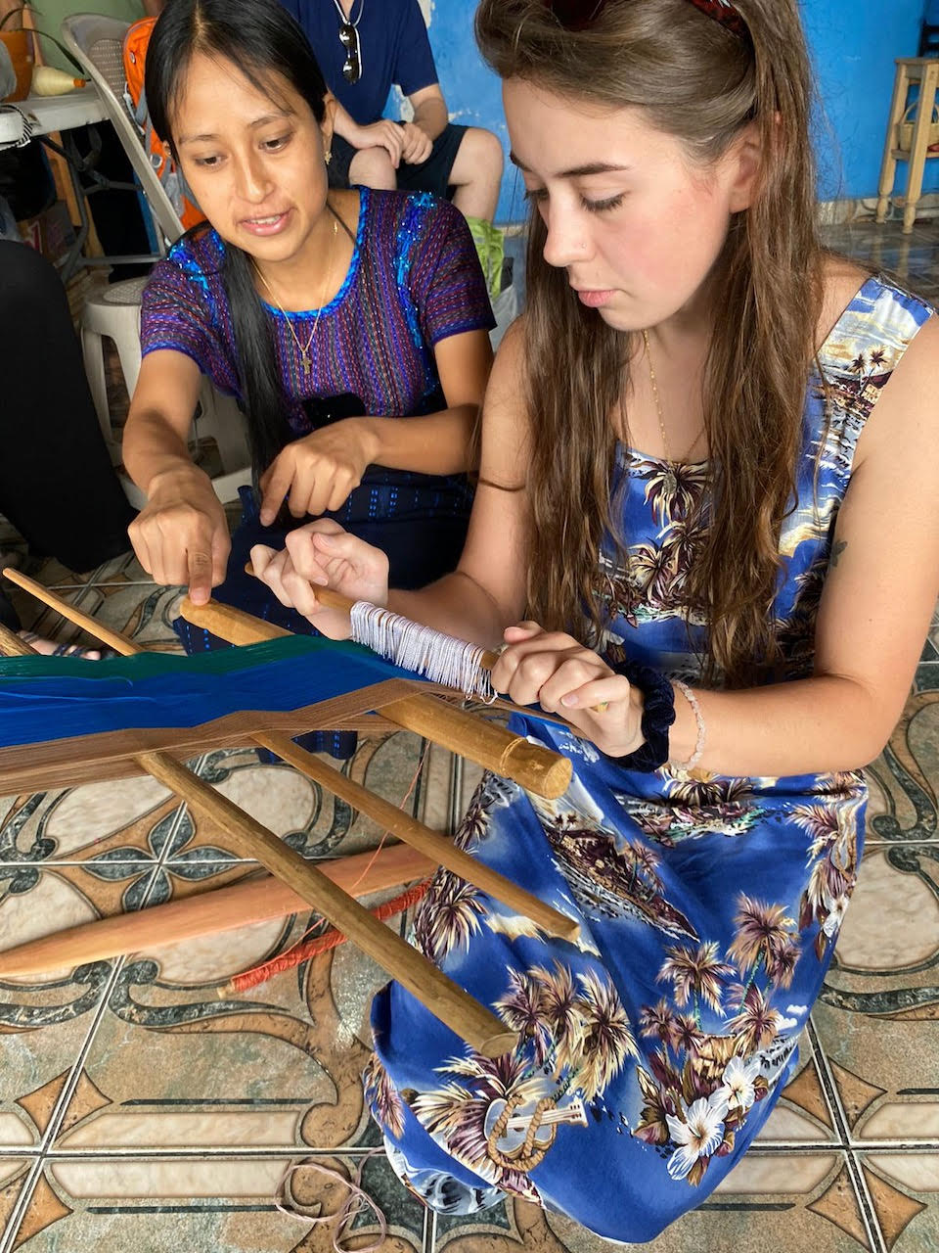
Traditional Weaving
Notes:
Site visit to Mayan women's cooperative
Students will receive a weaving demonstration of the traditional backstrap weaving technique, enjoy a traditional lunch, and take a tour around the town to see important sites such as the local ceramic factory and church.

Slide 11
Lake Atitlan
Notes:
2 hour transfer to Lake Atitlan
Group lunch on the way to Panajachel at a restaurant with a view of the lake

Slide 12
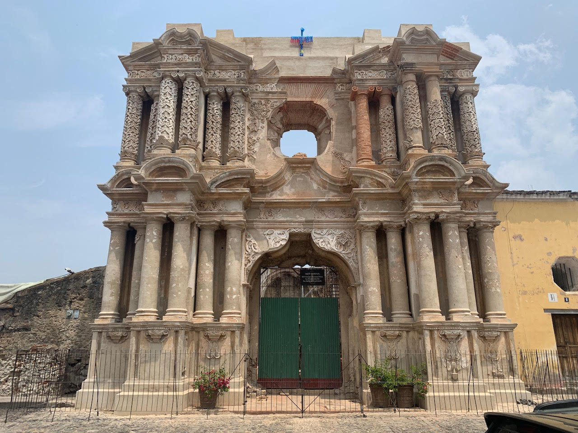

Slide 13
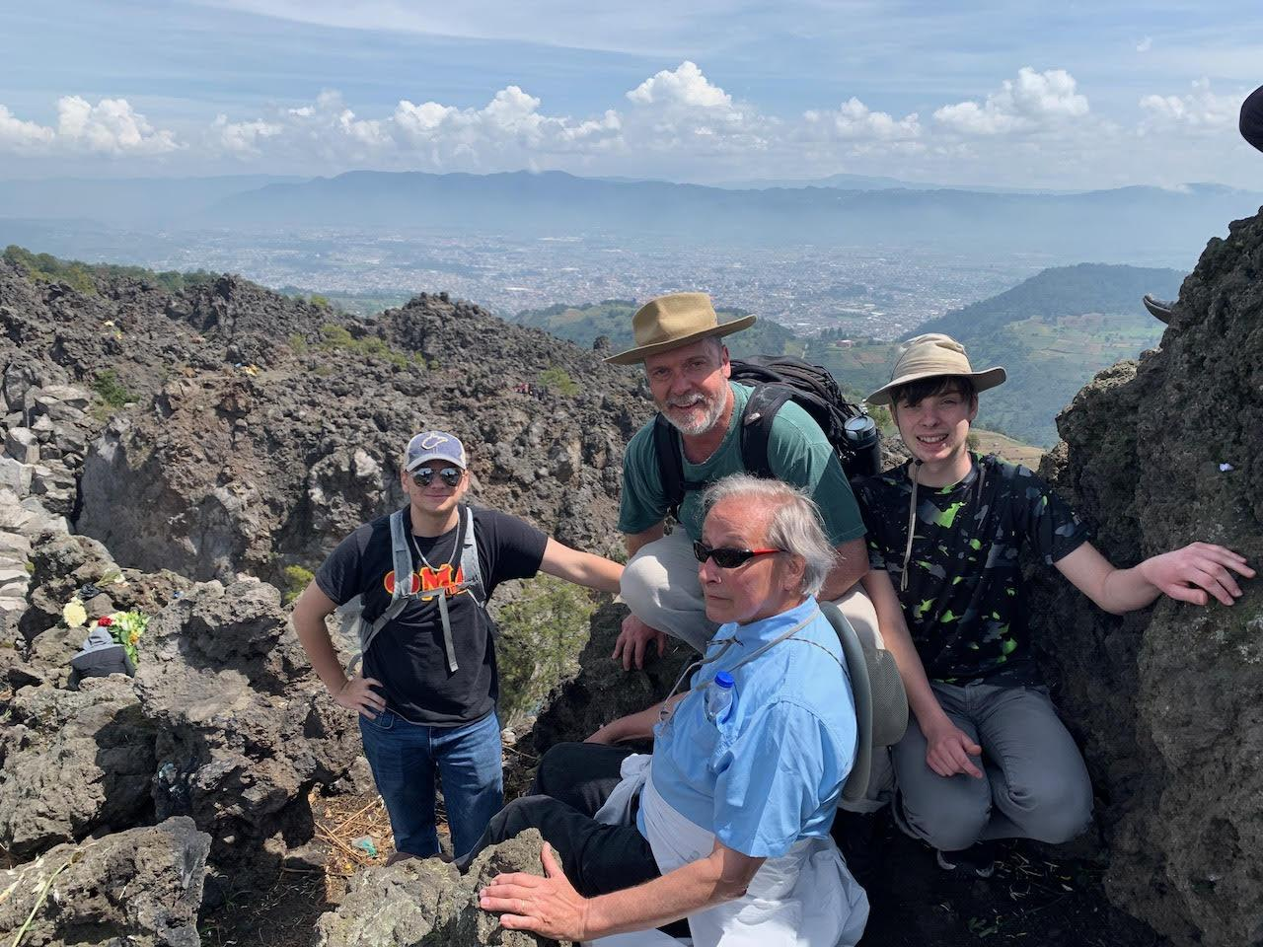

Slide 14
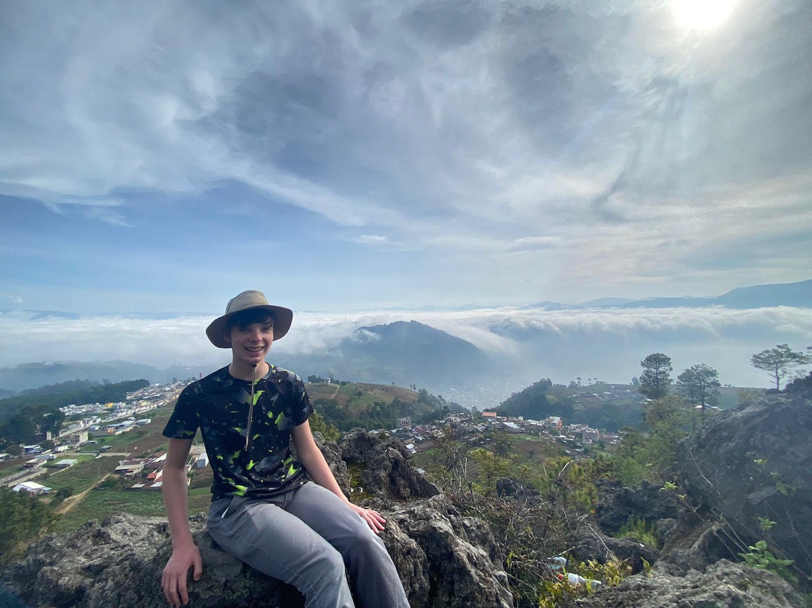

Slide 15
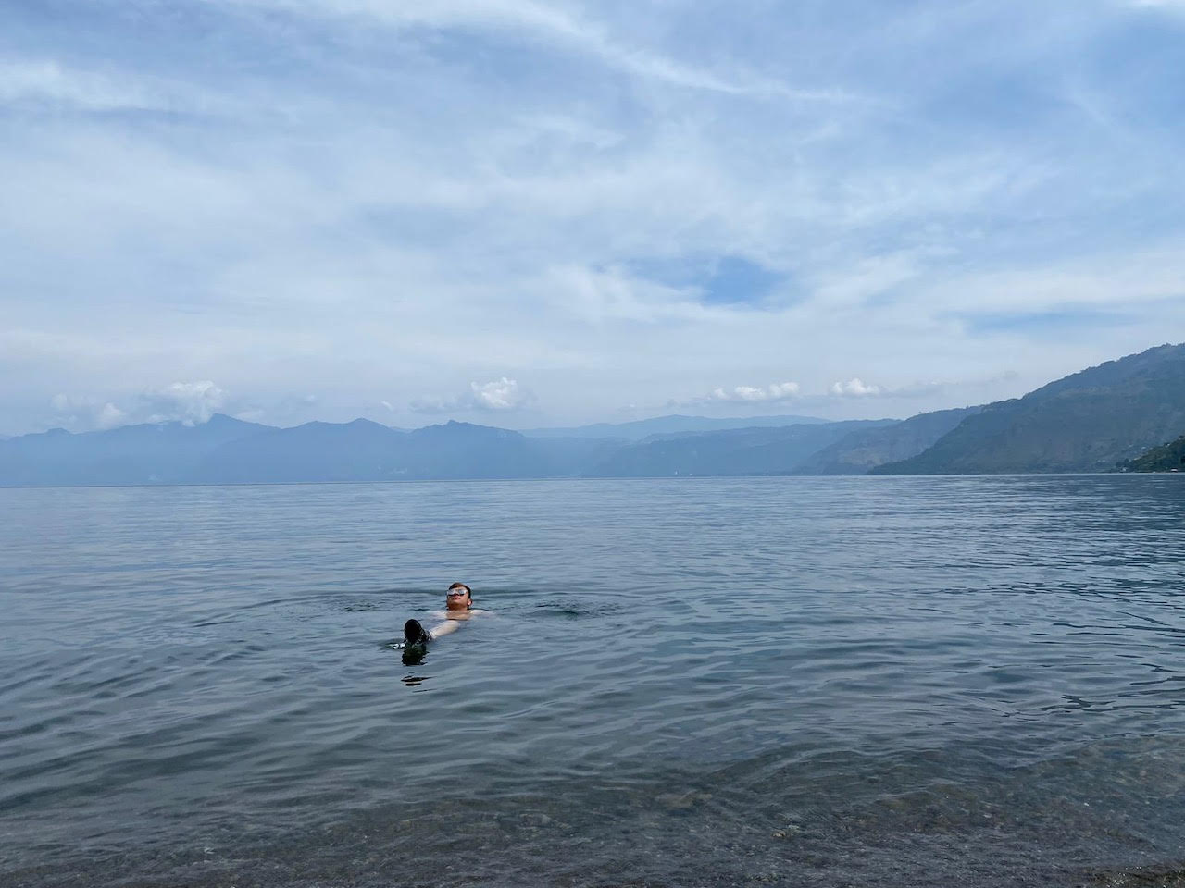

Slide 16
Course Credit
HIST 399A / PSCI 424

Slide 17
COST
Program Fee: $2,790-$3,190
Includes
Lodging
Activities
Most meals
Transport
Guide
Excludes
Tuition
Airfare
Personal expenses
Some meals
Passport fees
Notes:
Cost depends on total enrollment
Includes
All breakfast and lunches and some dinners
Does not include airfare or tuition

Slide 18
Registration and more info
https://bit.ly/ShepherdGuate

Slide 19
Contact:
Dr. Keith Alexander:
kalexand@shepherd.edu

